Slide 1
Protein Sorting and Targeting
1
PRESENTER : DR. L. ZHOYIO PHIMU
GUIDE : DR. MAUCHUMI S PATHAK

Slide 2
Objectives
2
▶ Introduction
▶ Sorting
▶ Targeting
▶ Intracellular protein traffic
▶ Clinical aspect
▶ Summary

Slide 3
Introduction
3
▶ Protein sorting and targeting is the biological mechanism by which proteins are sorted and targeted simultaneously together to their appropriate destinations within or outside the cell.
▶ It was first recognized by Blobel in 1970 that for proteins to attain their proper locations, they generally contain information (a signal or coding sequence) that targets them appropriately.
▶ This led to the identification of a number of the specific signals and it became apparent that certain diseases result from mutations that affect these signals.

Slide 4
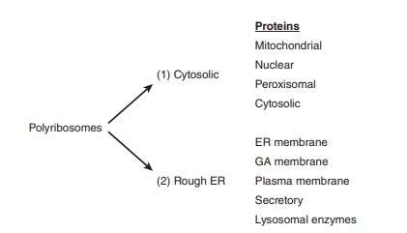
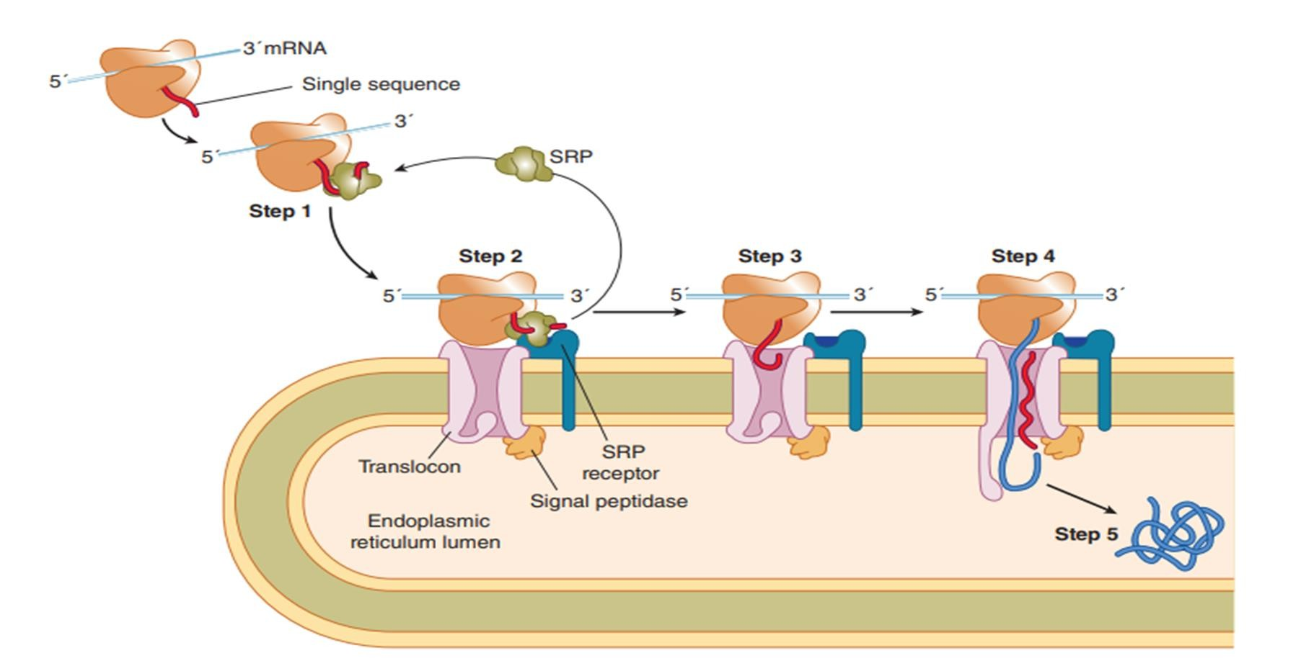
Sorting
4
Ref : Harper’s Illustrated Biochemistry

Slide 5
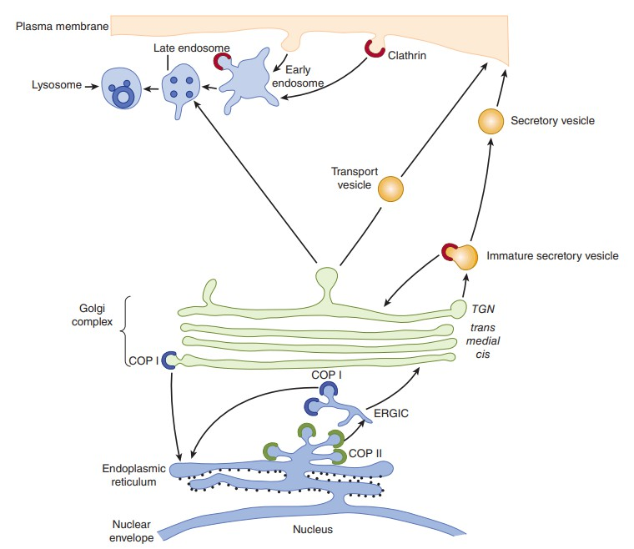
Sorting
5
Ref : Harper’s Illustrated Biochemistry

Slide 6
Sequences or Molecules That Direct Proteins to Specific Organelles
6
Targeting Sequence or Compound | Organelle Targeted
N-terminal signal peptide | ER
Carboxyl-terminal KDEL sequence (Lys-Asp- Glu-Leu) in ER-resident proteins in COPI vesicles | Lumen of ER
Di-acidic sequences (eg, Asp-X-Glu) in membrane proteins in COPII vesicles | Golgi membranes
Amino terminal sequence (20-50 residues) | Mitochondrial matrix
NLS (eg, Pro2 -Lys3 -Arg-Lys-Val) | Nucleus
PTS (eg, Ser-Lys-Leu) | Peroxisome
Mannose 6-phosphate | Lysosome

Slide 7
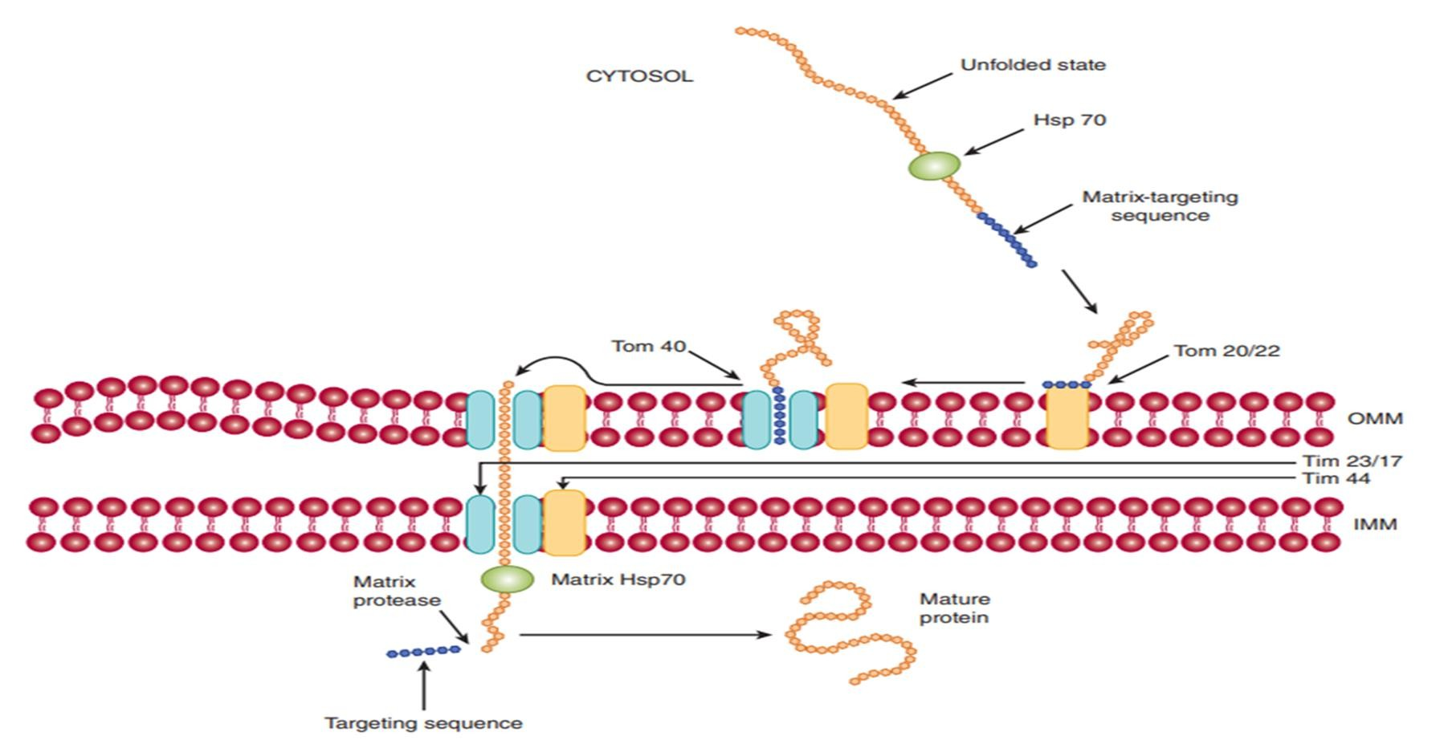
Targeting of protein into Mitochondrial Membrane
7
Ref : Harper’s Illustrated Biochemistry

Slide 8
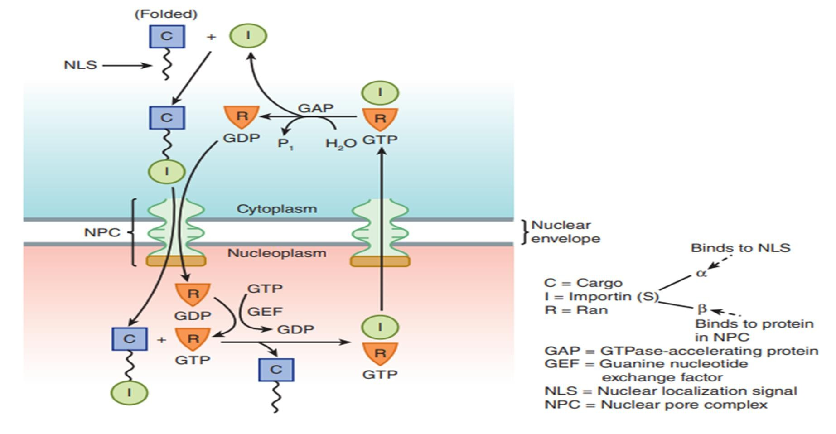
Targeting of protein into nucleus
8
Ref : Harper’s Illustrated Biochemistry

Slide 9
Nuclear and Mitochondrial Protein Targeting
9
Nuclear proteins
Translocate into nucleus via special
pores.
Pores are large in size and can easily accommodate transport of proteins in native state.
So, proteins need not to be unfolded for transport.
Mitochondrial proteins
A targeting sequence at the amino
terminus directs their translocation.
Proteins need to be in unfolded state
Chaperones help the protein to be in the unfolded state which is required in the translocation.

Slide 10
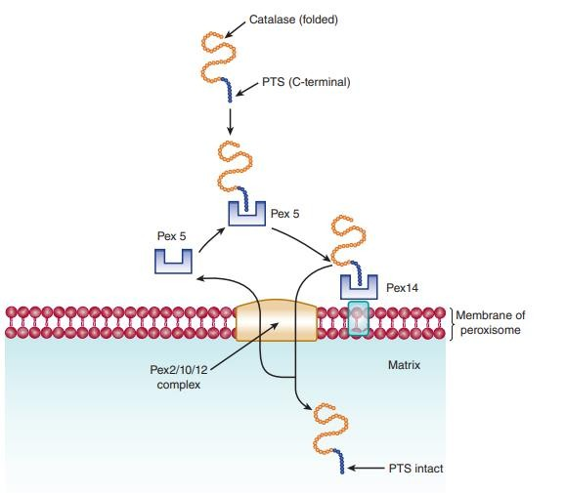
Targeting of protein into peroxisome
10
Ref : Harper’s Illustrated Biochemistry

Slide 11
Peroxisome
11
▶ At least two peroxisomal–matrix targeting sequences (PTSs) have been discovered.
▶ One, PTS1, is a tripeptide (i.e., Ser-Lys-Leu [SKL], but variations of this sequence have been detected) located at the carboxyl terminal of a number of matrix proteins, including catalase.
▶ Another, PTS2, is a nine amino acid sequence at the N-terminus and has been found in at least four matrix proteins (e.g., thiolase).
▶ Neither of these two sequences is cleaved after entry into the matrix.
▶ Proteins containing PTS1 sequences form complexes with a cytosolic receptor protein (Pex5) and proteins containing PTS2 sequences complex with another receptor protein (Pex7).

Slide 12
Properties of Signal Peptides Directing Proteins to the ER
12
▶ Usually, but not always, located at the amino terminal.
▶ Contain approximately 12-35 amino acids.
▶ Methionine is usually the amino terminal amino acid.
▶ Contain a central cluster (∼6-12) of hydrophobic amino acids.
▶ The region near the N-terminus usually carries a net positive charge.
▶ The amino acid residue at the cleavage site is variable, but residues −1 and −3
relative to the cleavage site must be small and neutral.

Slide 13
Principal components involved in ER Co-translocation
13
▶ N-terminal signal peptide
▶ Polyribosomes
▶ SRP, signal recognition particle
▶ SRP-R, signal recognition particle receptor
▶ Sec 61, the translocon
▶ Signal peptidase

Slide 14
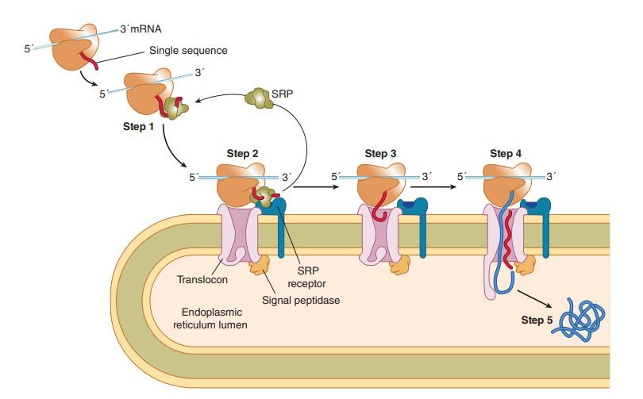
Targeting of secretory proteins
14
Ref : Harper’s Illustrated Biochemistry

Slide 15
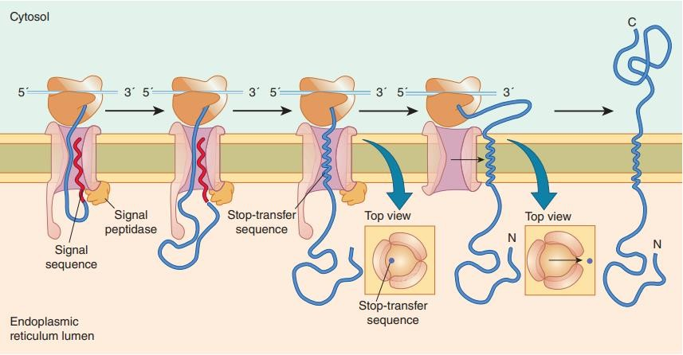
Targeting of Membrane Proteins
15
Ref : Harper’s Illustrated Biochemistry

Slide 16
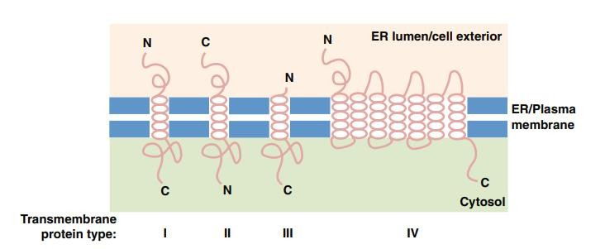
Variations in the way in which proteins are inserted into membranes
16
▶ Type 1 : LDL receptor
▶ Type 2 : The asialoglycoprotein receptor
▶ Type 3 : Cytochrome P450
▶ Type 4 : G-protein coupled receptor
Ref : Harper’s Illustrated Biochemistry

Slide 17
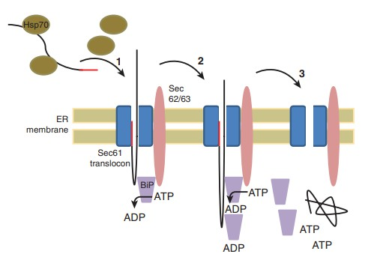
Post translational translocation
17
Ref : Harper’s Illustrated Biochemistry

Slide 18
GA routes include retention with retrieval to ER and also retrograde transport
18
▶ Anterograde transport–
Transport from ER to the Golgi apparatus or plasma membrane occurs in COP-II vesicles.
▶ Retrograde transport –
Movement of proteins from the Golgi apparatus to the ER occurs in
COP-I vesicles.
▶ Movement of proteins through the GA appears mainly by cisternal maturation.

Slide 19
19
▶ In the TGN, the exit side of Golgi, proteins are segregated and sorted.
▶ Secretory proteins accumulate in secretory vesicles, from which they are expelled at plasma membrane.
▶ Protein destined for plasma membrane or those secreted in constitutive
manner are carried up to the cell surface in transport vesicles.
▶ Clathrin-coated vesicles are involved in endocytosis, carry cargo to late
endosomes and to lysosomes.

Slide 20
Some Chaperones and Enzymes Involved in Folding That Are Located in the Rough Endoplasmic Reticulum
20
▶ BiP (immunoglobulin heavy chain binding protein)
▶ GRP94 (glucose-regulated protein)
▶ Calnexin (calcium binding protein)
▶ Calreticulin (calcium binding protein)
▶ PDI (protein disulfide isomerase)
▶ PPI (peptidyl prolyl cis-trans isomerase)

Slide 21
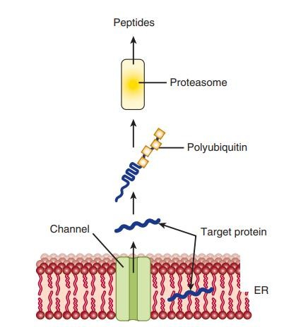
MISFOLDED PROTEINS UNDERGO ENDOPLASMIC RETICULUM-ASSOCIATED DEGRADATION
21
Ref : Harper’s Illustrated Biochemistry

Slide 22
TRANSPORT VESICLES ARE KEY PLAYERS IN INTRACELLULAR PROTEIN TRAFFIC
22
Vesicles lie at the heart of intracellular transport of many proteins
VESICLE | FUNCTION
COPI | Involved in intra-GA transport and retrograde transport from the GA to the ER
COPII | Involved in export from the ER to either ERGIC or the GA
Clathrin | Involved in transport in post-GA locations including the PM, TGN and endosomes
Secretory vesicles | Involved in regulated secretion from organs such as the pancreas (eg, secretion of insulin)
Vesicles from the TGN to the PM | They carry proteins to the PM and are also involved in constitutive secretion

Slide 23
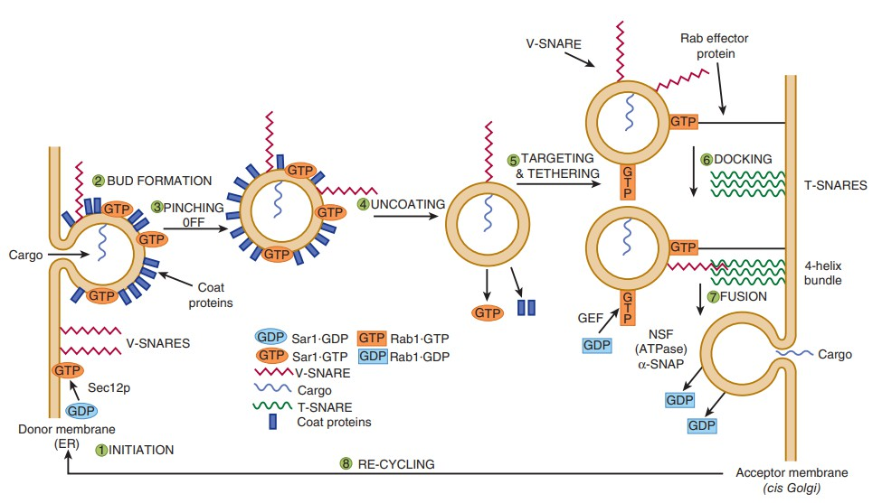
Transport Vesicles Involves SNAREs & Other Factors
23
Ref : Harper’s Illustrated Biochemistry

Slide 24
Some Transport Vesicles Travel via the Trans Golgi Network
24
▶ Proteins in the apical or basolateral areas of the plasma membranes of polarized epithelial cells can be transported to these sites in transport vesicles budding from the trans Golgi network.
▶ Different Rab proteins likely direct some vesicles to apical regions and others to basolateral regions.
▶ In certain cells, proteins are first directed to the basolateral membrane, then
endocytosed and transported across the cell by transcytosis to the apical region.

Slide 25
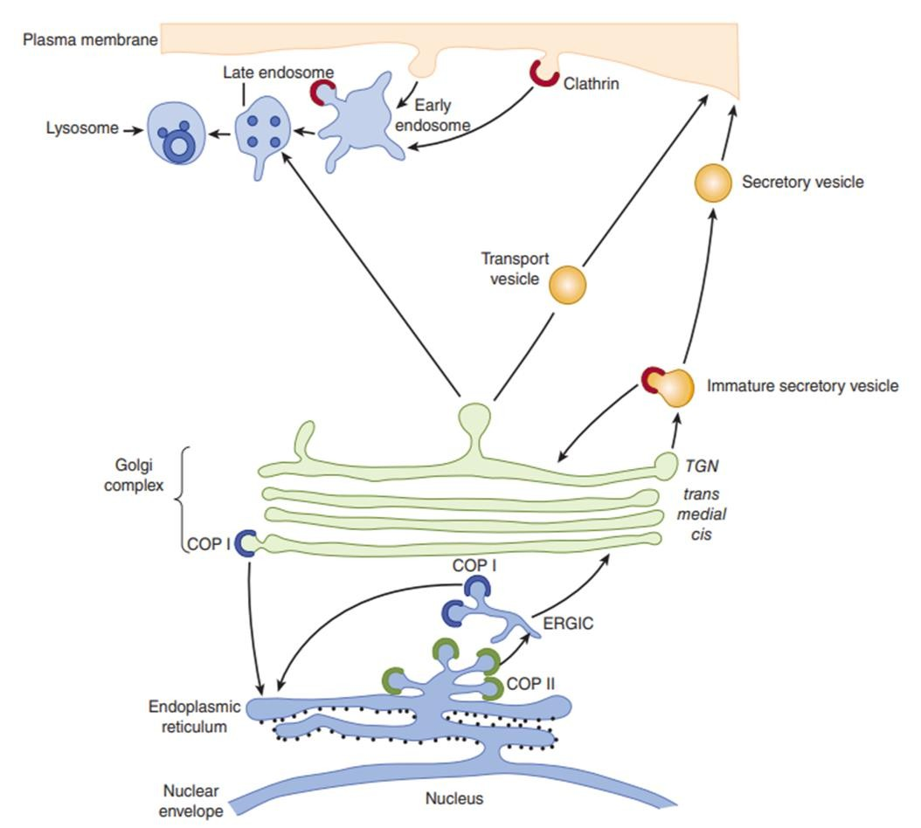
▶ Once proteins in the secretory pathway reach the cis-Golgi from the ER in vesicles, they can travel through the GA to the trans-Golgi in vesicles, or by a process called cisternal maturation, in which the cisternae move and transform into one another, or perhaps in some cases diffusion via intracisternal connections that have been observed in some cell types.
25
▶ In this model, vesicular elements from the ER fuse with one another to help form the cis-Golgi, which in turn can move forward to become the medial Golgi, etc.
▶ COPI vesicles return Golgi enzymes (e.g., glycosyltransferases) back from distal cisternae of the GA to more proximal (e.g., cis) cisternae.

Slide 26
Some Proteins Undergo Further Processing While Inside Vesicles
26
Ref : Harper’s Illustrated Biochemistry

Slide 27
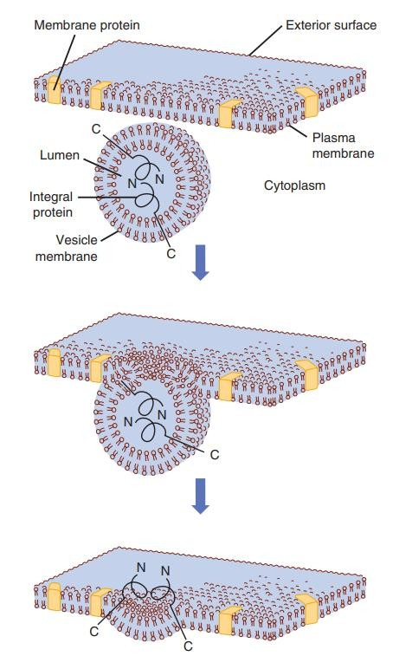
Membrane Assembly
27
Ref : Harper’s Illustrated Biochemistry

Slide 28
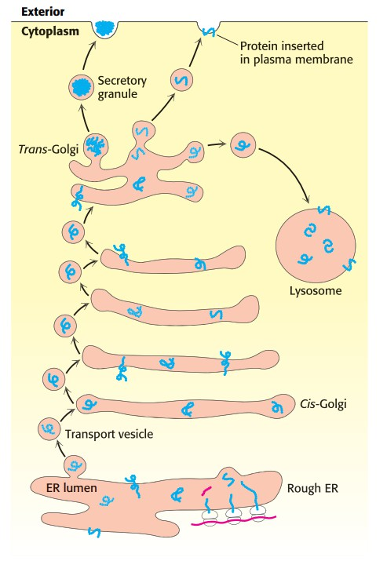
Transport vesicles carry cargo proteins to their final destination
28
Ref : Biochemistry Jeremy M Berg

Slide 29
Clinical Aspect
29
Why disorders arises in sorting and targeting of the protein?
Mutations that affect protein targeting signals.
Mutations affecting intracellular sorting of individual proteins
Changes in post translational modification.
Deregulation of protein trafficking machinery.
Improper folding/ improper maturation of proteins

Slide 30
Clinical Aspect
30
Disease | Affected protein
α1-Antitrypsin deficiency with liver disease | α1-Antitrypsin (SERPINA 1 gene)
Chediak-Higashi syndrome | Lysosomal trafficking regulator (Lyst gene)
Combined deficiency of factors V and VIII | ERGIC53, a mannose-binding lectin (LMAN1)
Cystic fibrosis | CFTR
Familial hypercholesterolemia, AD | LDL receptor (LDLRAP-1 gene)
Gaucher disease | β-Glucosidase (GBA)
I-cell disease | N-acetylglucosamine 1-phosphotransferase
Tay-Sachs disease | β-Hexosaminidase
von Willebrand disease | von Willebrand factor
Lowe oculocerebrorenal syndrome | PIP25-phosphatase (OCRL)
Hereditary hemochromatosis | HFE
Hemophilia A and B | Factors VIII and IX
Hermansky-Pudlak syndrome | AP-3 adaptor complex β3A subunit (HPS-1 gene)

Slide 31
Clinical Aspect
31
▶ Some of the disorders due to peroxisomal abnormalities :
Zellweger Syndrome (PEX 5)
Neonatal adrenoleukodystrophy (PEX 5)
Infantile Refsum disease (PEX 12)
Hyperpipecolic acidemia (PEX 1)
Rhizomelic chondrodysplasia punctata (PEX 7)
Adrenoleukodystrophy (PEX 1)
Pseudoneonatal adrenoleukodystrophy (ACOX 1)
Pseudo-Zellweger syndrome (HSD17B4)
Hyperoxaluria type 1 (AGXT)
Acatalasemia (CAT)
Glutaryl-CoA oxidase deficiency (C7ORF10)

Slide 32
Clinical Aspect
32
▶ Zellweger Syndrome :
apparent at birth and is characterized by profound neurologic impairment, victims often dying within a year.
Biochemical findings include an accumulation of very-long-chain fatty acids, abnormalities of the synthesis of bile acids, and a marked reduction of plasmalogens.
The condition is usually caused by mutations in genes encoding certain proteins
—the PEX family of genes, also called peroxins —involved in various steps of peroxisome biogenesis.

Slide 33
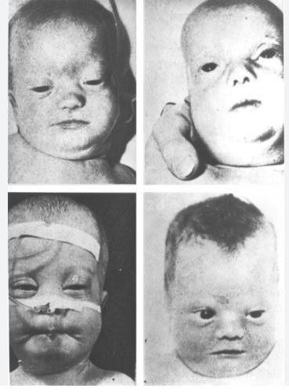
Two closely related conditions are neonatal adrenoleukodystrophy and infantile Refsum disease.
Zellweger syndrome and these two conditions represent a spectrum of overlapping features.
Where Zellweger syndrome being the most severe (many proteins affected) and infantile Refsum disease the least severe (only one or a few proteins affected)
33
Ref : Scriver CR, Beaudet AL, Sly WS, et al., eds. The Metabolic and Molecular Bases of Inherited
Disease. New York, NY: McGraw Hill; 1994:2297.

Slide 34
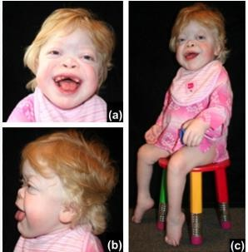
Clinical Aspect
Mucolipidosis II(I cell disease) : Inclusion cell disease
34
▶ Mutations in the gene encoding GlcNAc phosphotransferase .
▶ Results in the absence of Mannose-6-Phosphate signal for lysosomal localization of certain hydrolases.
▶ Lysosomes lack in enzymes which are seen in blood.
▶ Lysosomes accumulate different types of undegraded molecules(oligosaccharides, lipids, GAGs) forming inclusion bodies.
▶ C/F : Hepatomegaly, splenomegaly, Failure to grow and develop, Recurrent respiratory tract infection, Death from Congestive cardiac failure or Recurrent respiratory tract infection before 7th year of life.
Ref : Jules G Leroy, Chapter 103 - Oligosaccharidoses: Disorders Allied to the Oligosaccharidoses,Editor(s): David Rimoin, Reed Pyeritz, Bruce Korf,Emery and Rimoin's Principles and Practice of Medical Genetics (Sixth Edition),Academic Press,2013,Pages 1- 51,ISBN 9780123838346

Slide 35
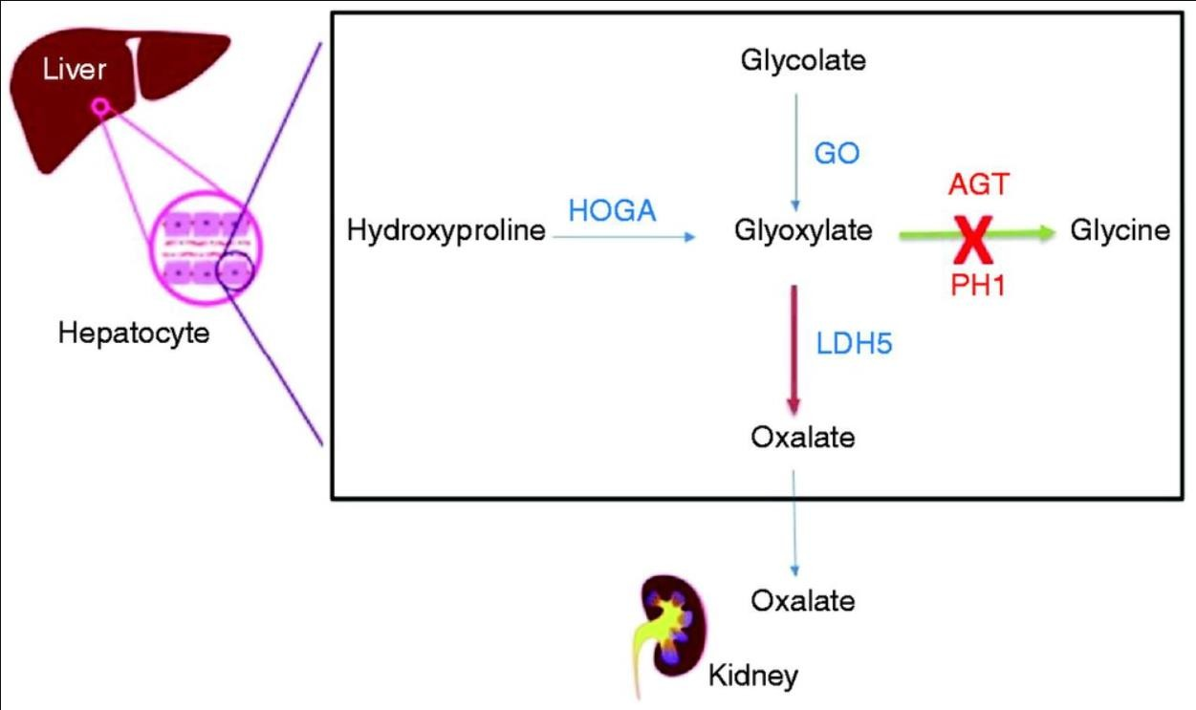
Clinical Aspect
Primary Hyperoxaluria
35
▶ Enzyme Alanine Glyoxalate aminotransferase is seen in mitochondria, instead of its normal peroxisomal location.
▶ Inactive enzyme results in increased pool size of glyoxalate, and excess production of oxalate.
▶ Patients suffer from neprolithiasis, renal colic
and hematuria.
▶ Extrarenal oxalosis may be seen in heart, blood
vessels, bone.
Ref : Garrelfs, Sander F.; van Harskamp, Dewi; Peters-Sengers, Hessel; van den Akker, Chris H.P.; Wanders, Ronald J.A.; Wijburg, Frits A.; van Goudoever, Johannes B.; Groothoff, Jaap W.; Schierbeek, Henk; Oosterveld, Michiel J.S.. Endogenous Oxalate Production in Primary Hyperoxaluria Type 1 Patients. JASN 32(12):p 3175-3186, December 2021. | DOI: 10.1681/ASN.2021060729

Slide 36
Clinical Aspect
36
Cystic fibrosis
▶ Due to mutation of Cystic fibrosis transmembrane regulator(CFTR) gene resulting in improper localization of proteins, AR.
▶ Affects cells that produce sweat, mucus and digestive juices.
▶ Mutation disrupts the function of chloride channel, preventing usual flow of chloride and water into and out of the cells.
▶ Very high Cl levels in sweat (> 60 mmol/L)
▶ Due to excessive excretion of chloride, body makes thick sticky mucus instead of thin watery mucus.
▶ The thick mucus clogs and blocks tubes and ducts resulting in damage to the lungs,
digestive system and other organs.

Slide 37
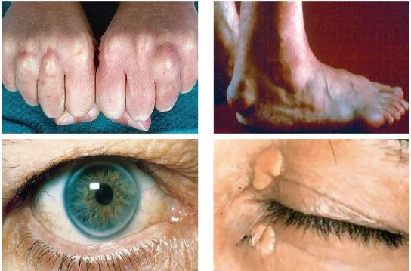
Clinical Aspect
Familial Hypercholesterolemia
37
▶ Due to deficient transport signals.
▶ LDL receptor defect results in high LDL levels in plasma.
▶ Receptor deficiency.
▶ Receptor does not reach target membrane of liver and peripheral tissues.
▶ Defective binding of B-100 to LDL receptor.
Ref : Yuan, George & Wang, Jian & Hegele, Robert. (2006). Heterozygous familial hypercholesterolemia: An underrecognized cause of early cardiovascular disease. CMAJ : Canadian Medical Association journal = journal de l'Association medicale canadienne. 174. 1124-9. 10.1503/cmaj.051313.

Slide 38
Clinical Aspect
38
▶ Prion Diseases
AKA spongiform encephalopathies, transmissible, fatal neurological degenerative
diseases caused by obnoxious protein aggregates.
Creutzfeldt-Jakob disease and kuru.
Prion proteins have certain changes in three dimensional structures.
Major replacement of -helix by β-sheets.
Forming an abnormal isoform called prion protein-cellular form (PrPC).
This abnormal conformation makes it resistant to the action of proteolytic enzymes.
These proteins are highly infectious in nature.

Slide 39
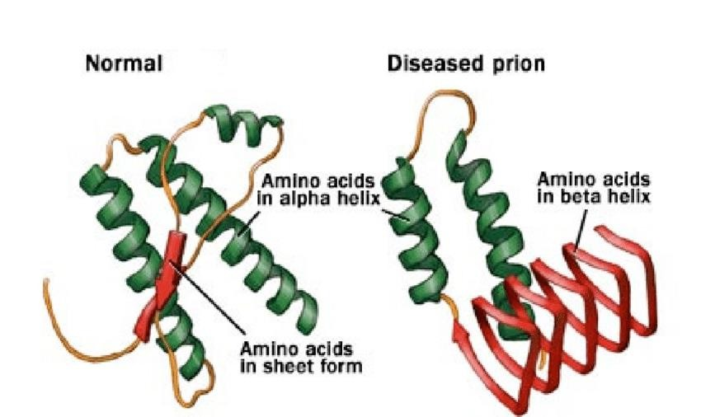
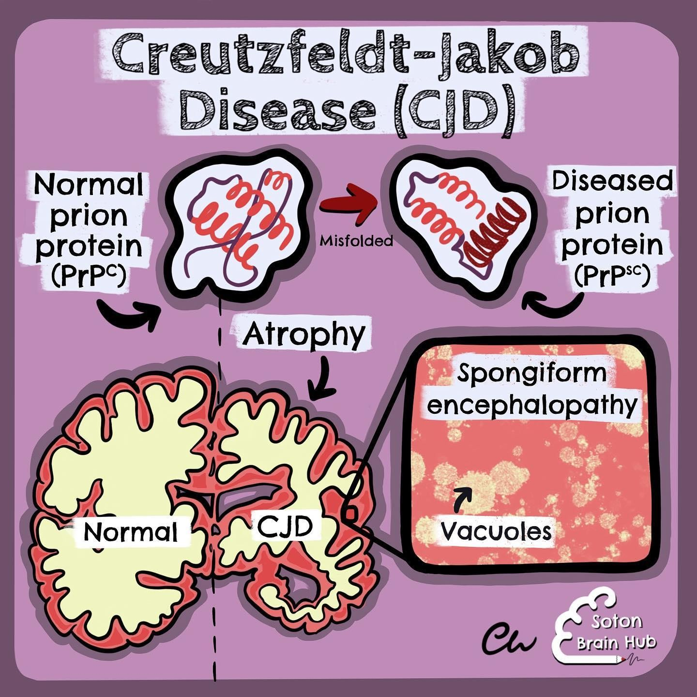
39
Ref : Paudyal, Anuja & Gillock, Eric. (2017). FHSU Scholars Repository Polymorphism In The PrPC Prion Protein Gene In Pigs.
10.13140/RG.2.2.12822.86089.
Ref : https://medium.com/@bagwe.aditya05/creutzfeldt-jakob-disease-cjd-125ba6dce1e5

Slide 40
▶ Many other mutations affecting folding of proteins and their intracellular transport to various organelles have been reported, including neurodegenerative disorders such as Alzheimer disease, Huntington disease and Parkinson disease.
40
▶ The elucidation of the causes of these various conformational disorders has contributed significantly to our understanding of molecular pathology.
▶ The term “diseases of proteostasis deficiency "has also been applied to
diseases due to misfolding of proteins.
▶ Proteostasis is a composite word derived from protein homeostasis.
▶ Normal proteostasis is due to a balance of many factors, such as synthesis, folding, trafficking, aggregation, and normal degradation.
▶ If any one of these is disturbed (e.g., by mutation, aging, cell stress, or injury), a variety of disorders can occur, depending on the particular proteins involved.

Slide 41
Summary
Signal sequences : targets the proteins to their specific destination.
41
Sorted : cytosolic or RER.
Protein are targeted accordingly in the MM, Nucleus, Peroxisome and ER.
Proteins embedded in ER undergoes Co-translational, Post-translational, Anterograde and
Retrograde transport.
Misfolded proteins undergo degradation via ERAD pathway.
Transport vesicles, helps from budding to the movement through cytosol, tethering, docking and fusion, also plays a key role in the intracellular traffic of proteins.
Any Proteostatic deficiency due to mutations in gene or other factors causes diseases as
mentioned above.

Slide 42
References :
42
Harper’s Illustrated Biochemistry 30th edition Biochemistry Jeremy M Berg 8th edition Lehninger Principles of Biochemistry
FHSU Scholars Repository Polymorphism In The PrPC Prion Protein Gene In Pigs - Scientific Figure on ResearchGate. Available from: https://www.researchgate.net/figure/Normal-and-abnormal-form-of-prion- protein-Normal-prion-protein-has-amino-acids-in-alpha_fig1_326330981 [accessed 13 Mar, 2024]
Scriver CR, Beaudet AL, Sly WS, et al., eds. The Metabolic and Molecular Bases of Inherited Disease. New York, NY: McGraw Hill; 1994:2297.
Jules G Leroy, Chapter 103 - Oligosaccharidoses: Disorders Allied to the Oligosaccharidoses,Editor(s): David Rimoin, Reed Pyeritz, Bruce Korf,Emery and Rimoin's Principles and Practice of Medical Genetics (Sixth Edition),Academic Press,2013,Pages 1-51,ISBN 9780123838346
Garrelfs, Sander F.; van Harskamp, Dewi; Peters-Sengers, Hessel; van den Akker, Chris H.P.; Wanders, Ronald J.A.; Wijburg, Frits A.; van Goudoever, Johannes B.; Groothoff, Jaap W.; Schierbeek, Henk; Oosterveld, Michiel J.S..
Endogenous Oxalate Production in Primary Hyperoxaluria Type 1 Patients. JASN 32(12):p 3175-3186, December 2021. | DOI: 10.1681/ASN.2021060729
Yuan, George & Wang, Jian & Hegele, Robert. (2006). Heterozygous familial hypercholesterolemia: An underrecognized cause of early cardiovascular disease. CMAJ : Canadian Medical Association journal = journal de l'Association medicale canadienne. 174. 1124-9. 10.1503/cmaj.051313.
Paudyal, Anuja & Gillock, Eric. (2017). FHSU Scholars Repository Polymorphism In The PrPC Prion Protein Gene In
Pigs. 10.13140/RG.2.2.12822.86089.
10. https://medium.com/@bagwe.aditya05/creutzfeldt-jakob-disease-cjd-125ba6dce1e5
1.
2.
3.
4.
5.
6.
7.
8.
9.

Slide 43
43

